Slide 1
Provisioning And Monitoring Guavus Reflex Platform
Module 2

Slide 2
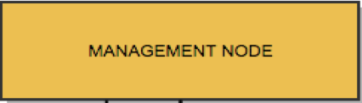
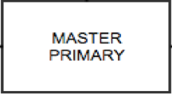
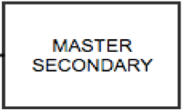
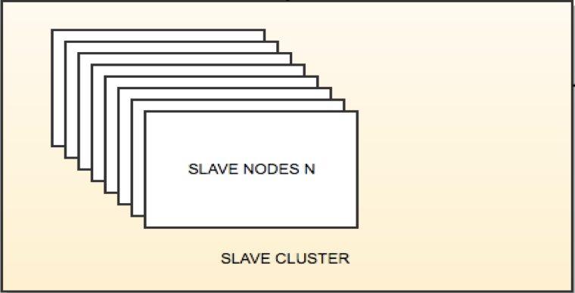
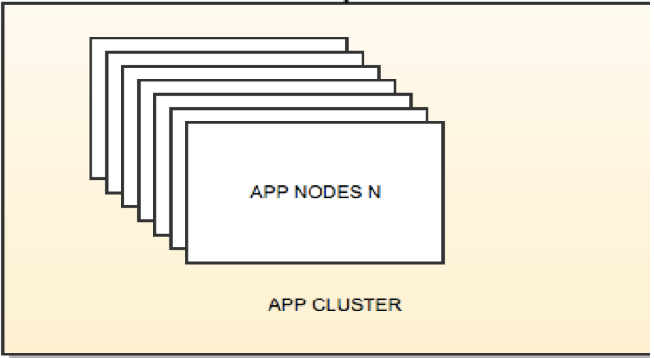
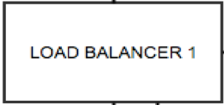
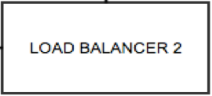
REFLEX | Physical Layout

Slide 3
Node | Management Node
Ambari
Grafana
Oozie Server
Knox Gateway
ElasticSearch Log Cluster Container
Curator Log Container
Kibana Log Container
ElasticSearch Pipeline Master Container
Kibana Pipeline Container
Atlas
Ranger
Spark2 History server
Notes:
Flannel on ALL

Slide 4
Node | Master Nodes
Kafka Server
CDAP
Hbase Master
Hive metastore
Schema Registry
Zeppelin
ZKFC(Zookeeper Failover Controller)
Resource Manager
NameNode
Journal Node
ElasticSearch Pipeline Master
ES Coordinator
JanusGraph
K8s Dashboard
Kubernetes
Kube API Server Container
Kube Controller Manger Container
Kube Proxy Container
Kube Scheduler Container

Slide 5
Node | Slave Nodes App Nodes
Hive Server
Kafka Broker
NiFi
Zookeeper Server
Hbase Region Server
DataNode
NodeManager
Redis
ETCD
Flannel Container
ES pipeline coordinator
ES pipeline ingest
ES pipeline data
Flannel Nodes

Slide 6
Node | LB Nodes All Nodes
KubeProxy
Fluentd
Flannel
HAProxy
Flannel Container

Slide 7
Subsystems
K8s Dashboard
Ambari for Operations
Container Orchestration K8s
ADLS
RANGER
Apps
KNOX
ATLAS
Reflex Microservices
KAFKA
Fluent
NIFI
CDAP
Flannel
HDFS
Kube Proxy
Spark Streaming
Hive
Spark
Kubelet
YARN Resource Manager
Docker Container Engine
Operating System – RHEL or CENTOS – Physical or Virtual machines

Slide 8
Subsystems
Ambari for Operations
Perimeter Security
Data Governance
Policy
Authentication
Ansible + Ambari Blueprints
ADLS
RANGER
KNOX
ATLAS
KAFKA
NIFI
CDAP
HDFS
Spark Streaming
Hive
Spark
Sources & Sinks
Ansible + Ambari Blueprint
Ansible + Ambari Blueprints
YARN Resource Manager
Operating System – RHEL or CENTOS – Physical or Virtual machines

Slide 9
Container Orchestration Subsystem
K8s Dashboard
Container Orchestration K8s
Apps
Application Ansible Playbook for deployment
Reflex Microservices
Fluent
Flannel
Base Ansible Playbook for deployment
Kube Proxy
Kubelet
Docker Container Engine
Operating System – RHEL or CENTOS – Physical or Virtual machines

Slide 10
ANSIBLE: For Provisioning Reflex Platform
Ansible is the tool of choice to automate provisioning of the Reflex Platform.
Ansible is used to automate provisioning of all Guavus stack components.
Let’s take a quick tour of Ansible first covering basics and terminologies.

Slide 11
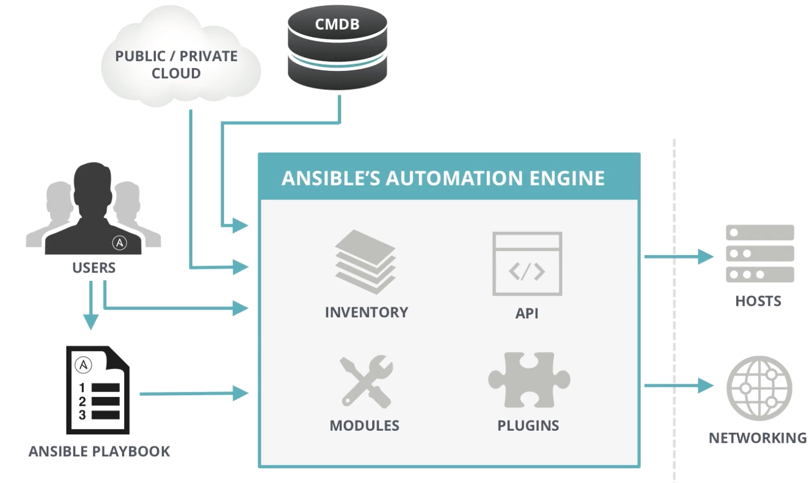
Ansible
automates software provisioning, configuration management, and application deployment.
No Agents; connects via SSH.
Plugins support
Dry run
Notes:
Needs change in diagram

Slide 12
Ansible Language Basics - Playbooks
Plain-text YAML files that describe the desired state of something
Human and machine readable
Can be used to build entire application environment

Slide 13
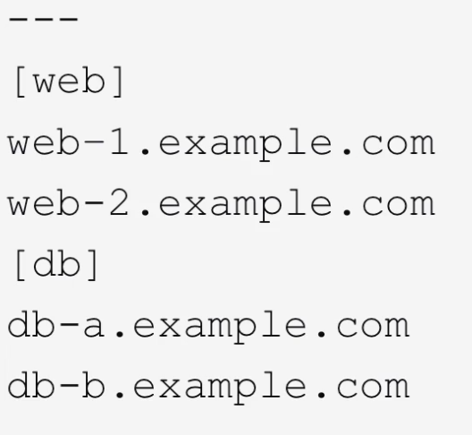
Ansible Language Basics - Hosts

Slide 14
Ansible Language Basics
Playbooks contains plays
Plays contain tasks
Tasks call modules
Tasks run sequentially
Handlers are triggered by Tasks,
And are run once, at the end of plays.

Slide 15
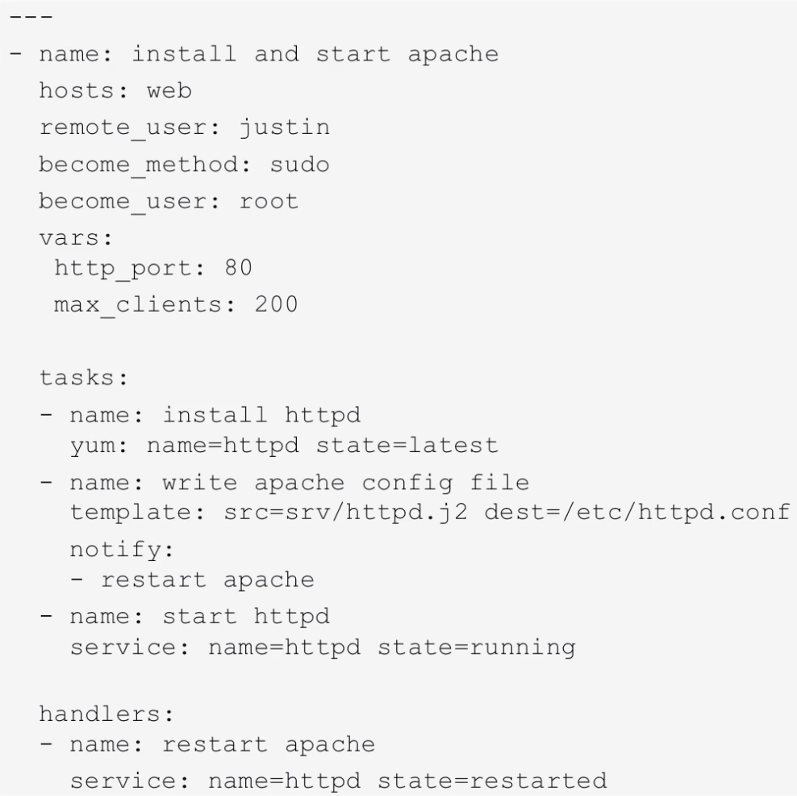

Slide 16
Ansible Language Basics: ADV PLAYBOOK CAPABILITIES
Ansible has many different ways to alter how Playbooks run:
https://docs.ansible.com/ansible/2.5/user_guide/playbooks_special_topics.html

Slide 17
Ansible Language Basics: Ansible Roles
Ansible Roles are a special kind of Playbook that are fully self-contained with tasks, variables, configurations templates and other supporting files.
https://docs.ansible.com/ansible/2.3/playbooks_roles.html

Slide 18
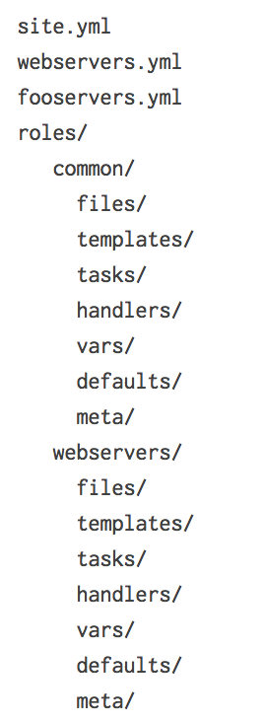
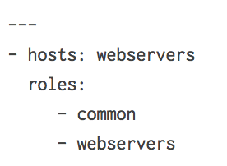
Roles

Slide 19
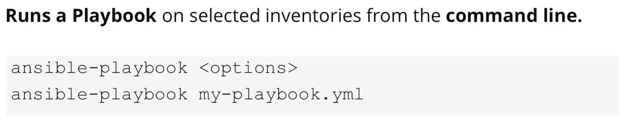
Using Ansible: RUNNING PLAYBOOKS

Slide 20
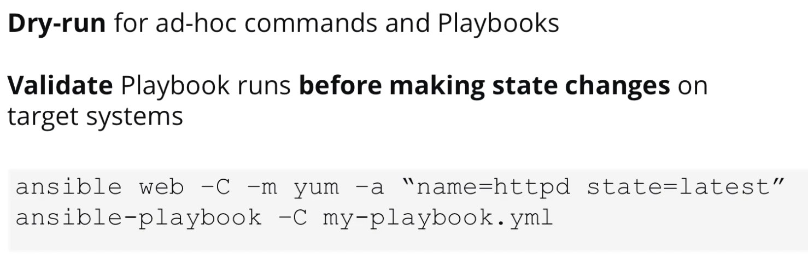
Using Ansible: DRY RUN

Slide 21
Reflex Provisioner

Slide 22
Ansible Deployment Scripts Layout
Inventories Generated through CLI – Specific to deployment, and only needs to be looked at for customizing
Inventory Templates – Look here for defaults and standard global’s
Complete install logs
Dependencies, not useful for Ops
Primary playbooks tree. All main playbooks and sub-playbooks reside here.
Inventory creation scripts
Internal Ansible modules used by all playbooks. This is the library of functions.

Slide 23
Install the Reflex Platform

Slide 24
Installation Steps (1)
Identify Prerequisites
Identify Installation Type
Ensure System Requirements
Operating System
OS Disk Partitioning layout
Data Disk layout for:
Management Node
Platform slave nodes
Platform Kafka nodes
Ensure hostname scheme

Slide 25
Installation Steps(2)
4. Setup Repositories
5. Setup Reflex Provisioner
6. Bootstrap Management server
7. Generate Inventory
8. Review and Refresh Inventory
9. Execute Playbooks
10. Verify Monitoring UI’s

Slide 26
1. Identify Pre-requisites

Slide 27
Pre-requisites
Obtain IP addresses for:
DNS Server
NTP Server
SMTP Server (Optional)
FQDNs (must be resolvable through DNS)
Load balancer floating IP address and FQDN
LDAP server URL, username, and password (required only if LDAP is used)
Swap should be permanently disabled on all cluster nodes.

Slide 28
2. Identify Installation Type

Slide 29
Installation Type
Server Role | Count | RAM (GB) | NIC (GBPS) | CPU Ghz | Cores | CPU Threads
Platform Master | 1 | 64 | 1 | 2.1 | 16 | 32
Platform Slave | 3 | 64 | 1 | 2.1 | 8 | 16
Non-HA (Sizing)
HA (Sizing)
Server Role | Count | RAM (GB) | NIC (GBPS) | CPU Ghz | Cores | CPU Threads
Management | 1 | 64 | 1 | 2.1 | 8 | 16
Load Balancer | 2 | 16 | 1 | 2.1 | 4 | 8
Application | 2 | 64 | 1 | 2.1 | 8 | 16
Platform Master | 2 | 64 | 1 | 2.1 | 8 | 16
Platform Slave | 3 | 64 | 1 | 2.1 | 8 | 16

Slide 30
3. Ensure Systems Requirements

Slide 31
Recommended System Requirements (1)
Operating System
CentOS 7.3.1611 minimal install
OS Disk Partitioning layout
Management Servers Data Disks
Zookeeper Servers Data Disks
Partition | Size (GB)
/ | 50
/var | 150
/var/log | 150
Partition | Size (GB)
/opt/repos | 400
Partition | Size (GB)
/hadoop/zookeeper | 50

Slide 32
Recommended System Requirements (2)
Partition | Size (GB)
/opt/data01 | 325
/opt/data02 | 325
/opt/data03 | 325
/opt/data04 | 325
Platform slave servers data disks
Platform slave servers Kafka disks
Partition | Size (GB)
/opt/kafka01 | 325
/opt/kafka02 | 325
/opt/kafka03 | 325
/opt/kafka04 | 325

Slide 33
Sample Hostnames for Nodes
Server Role | Production | Staging
Management | rflx-prod-mgt-01 | rflx-stg-mgt-01
Load Balancer | rflx-prod-lb-01, rflx-prod-lb-02 | rflx-stg-lb-01, rflx-stg-lb-02
Application | rflx-prod-app-01…rflx-prod-app-0x | rflx-stg-app-01…rflx-stg-app-0x
Platform Master | rflx-prod-mst-01, rflx-prod-mst-02 | rflx-stg-mst-01, rflx-stg-mst-02
Platform Slave | rflx-prod-slv-01…rflx-prod-slv-0x | rflx-stg-slv-01…rflx-stg-slv-0x

Slide 34
4. Setup Repositories

Slide 35
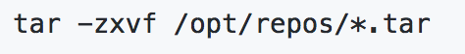
Copy Software packages
Copy the software packages to /opt/repos
Yum Repositories
CentOS
Docker
Reflex and other supporting repos
Pip
Hortonworks
Cask
…

Slide 36
5. Setup Reflex Provisioner

Slide 37
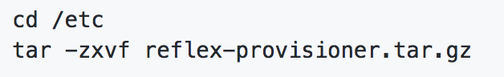
Copy Ansible packages
Copy/extract the Ansible packages to /etc
Ansible Scripts
reflex-provisioner.tar.gz
Extract all the transferred ansible packages.

Slide 38
Important Reflex Provisioner Files/Scripts
/etc/reflex-provisioner/bootstrap.sh
/etc/reflex-provisioner/scripts/generate_inventory/cli.py
/etc/reflex-provisioner/playbooks/*
/etc/reflex-provisioner/roles/*
/etc/reflex-provisioner/inventory/templates/*
Notes:
Group_vars directory
inventory/templates/group_vars/global/all/sampleapp/ : for customer specific variables those may be applicable to multiple deployments
inventory/templates/group_vars/customers/ : variable specific to a customer deployment
Vars directory
# - common #
# - customers/common
# - customers/stage
# - extra_vars

Slide 39
6. Bootstrap Management Server

Slide 40
/etc/reflex-provisioner/bootstrap.sh
Bootstraps the Ansible environment on the management node.
Primarily install ansible and ansible dependencies etc.

Slide 41
Local Bootstrap Management Server
Bootstrap the management server to install pre-requisites.
$ cd /etc/reflex-provisioner
$ sh bootstrap.sh prod

Slide 42
7. Generate Inventory

Slide 43
Generate Inventory Script Help
The list of all configuration options can be listed using the help option.
./scripts/generate_inventory/cli.py create --help

Slide 44
Cli Creation command
./scripts/generate_inventory/cli.py create \
--inventory_name=thales \
--customer_name=thales \
--floating_ip_addr=“10.70.1.11” \
--floating_ip_fqdn=reflex001-vip-01.devops.guavus.in \
--floating_ip_cidr=16 \
--floating_ip_inet=eth0 \
--nb_slv=3 \
--nb_app=3 \
--connectivity=offline \
--stage_type=prod \
--smtp_server=10.70.0.60 \
--ntp_server= 192.168.104.83 \
--dns_server=192.168.104.83 \
--domain_name=devops.guavus.in \
--data_mountpoint=/opt/data01
--data_mountpoint=/opt/data02

Slide 45
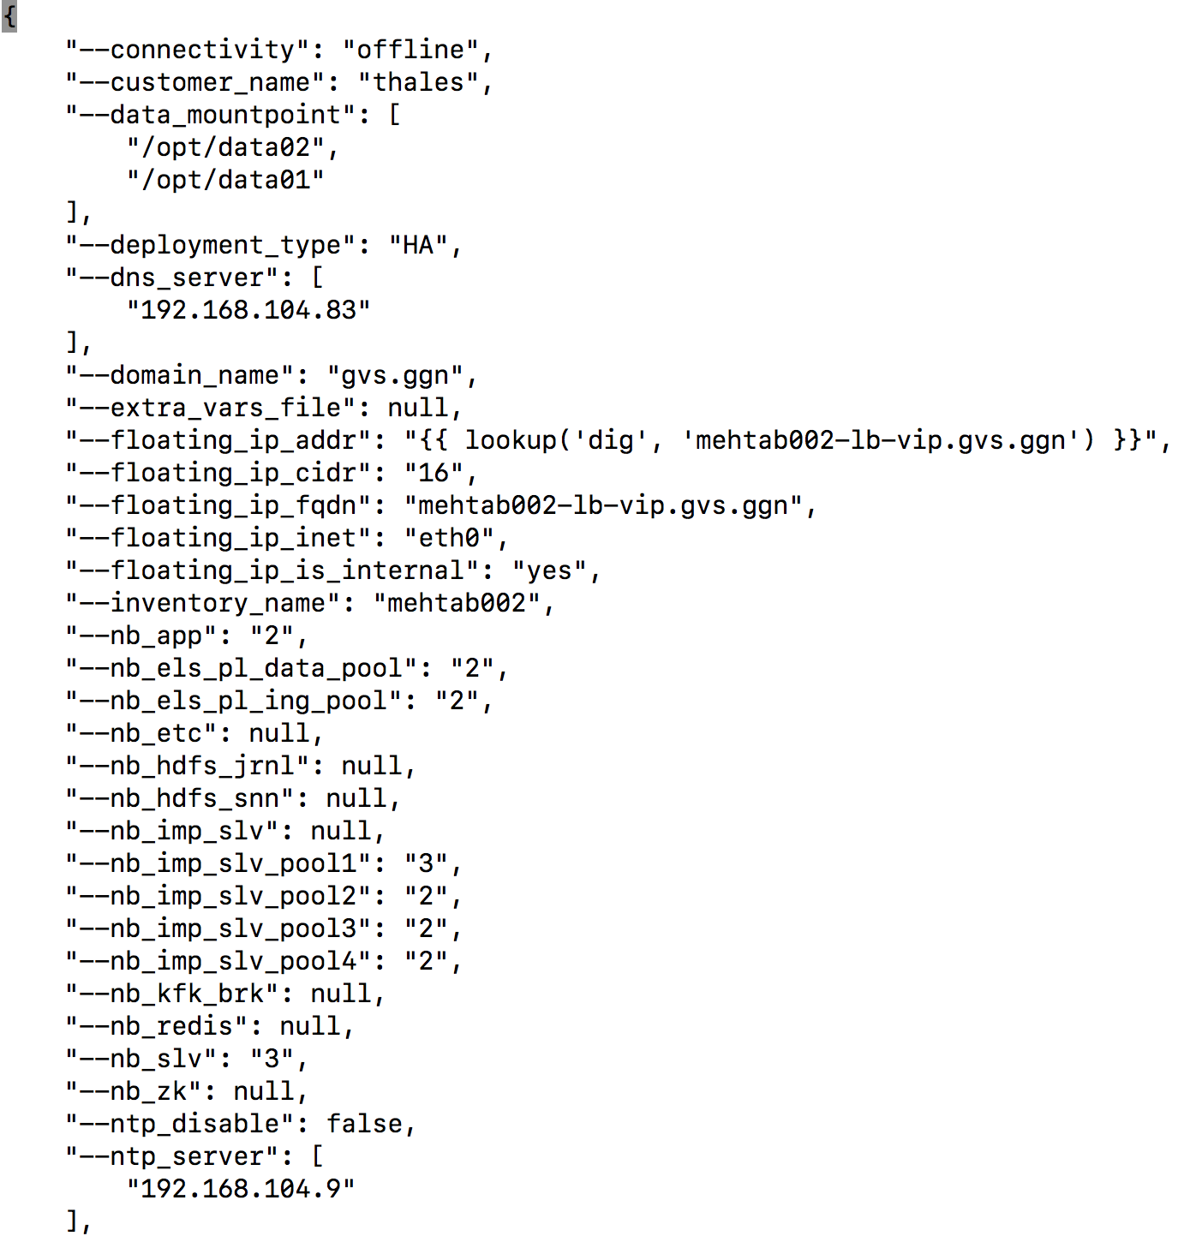
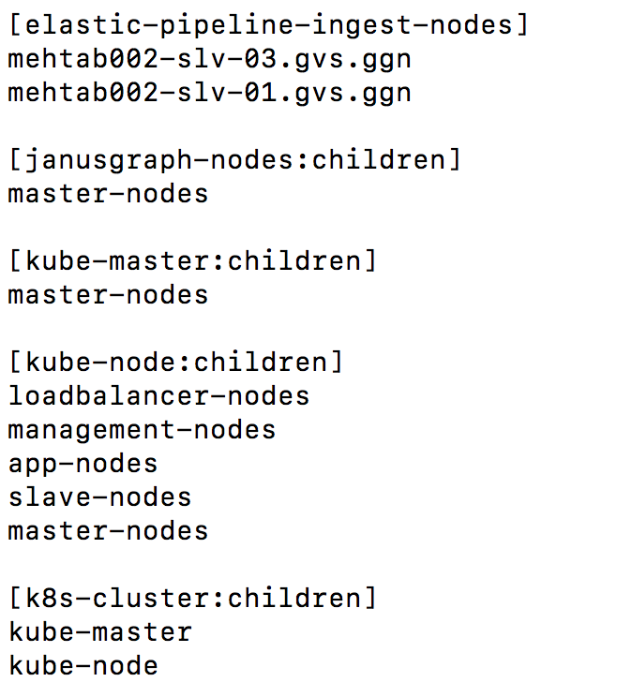
Inventory/Hosts
/etc/reflex-provisioner/scripts/generate_inventory/cli.py

Slide 46
Generated Inventory
reflex-provisioner/conf/generate_inventory/conf_inventory/<env type>/<inventory name>/
Review the following:
"generate_inventory.json" File
“hosts” file
Configure the "extra_vars.yml" File
Create the file /extra_vars/default.yml
Notes:
./conf/generate_inventory/conf_inventory/<env type>/<inventory name>/generate_inventory.json ./conf/generate_inventory/conf_inventory/<env type>/<inventory name>/hosts
./conf/generate_inventory/conf_inventory/<env type>/<inventory name>/hosts
reflex-provisioner/inventory/templates/group_vars/global/all

Slide 47
8. Verify and Refresh Inventory

Slide 48
Inventory Refresh
./scripts/generate_inventory/cli.py refresh --inventory_name thales --stage_type prod
Generated Inventory Path
/etc/reflex-provisioner/inventory/generated/prod/thales/

Slide 49
Verify and Refresh Inventory
Refreshing the inventory generates the final inventory from the templates.
/etc/reflex-provisioner/inventory/generated/prod/thales/*

Slide 50
9. Execute Playbooks

Slide 51
Base Platform Install
Base Platform Playbook
ansible-playbook -i inventory/generated/<env-type>/<inventory-name>/hosts playbooks/base_platform_deploy.yml --ask-pass --user root
full_stack - Contains all components (HDP + HDF + CDAP) ==> This is default value
cdap_stack - Contains HDP, Schema Registry, Kafka, CDAP (No ATLAS & NIFI)
nifi_stack - Contains HDP, HDF (No CDAP)
hdp_schReg_stack - Contains HDP, Schema Registry, Kafka (No CDAP, ATLAS & NIFI)

Slide 52
HDP Install
ansible-playbook -i playbooks/hortonworks/inventory/static playbooks/hortonworks/playbooks/install_hdp.yml --ask-pass --user root

Slide 53
ElasticSearch & Kibana (Optional)
Data Pipeline ELK Cluster Playbook
ansible-playbook -i inventory/generated/<env-type>/<inventory-name>/hosts playbooks/kubernetes/deploy-elastic-pipeline-cluster.yml --ask-pass --user root
ansible-playbook -i inventory/generated/<env-type>/<inventory-name>/hosts playbooks/kubernetes/deploy-kibana-pipeline-cluster.yml --ask-pass --user root

Slide 54
Install: Add-ons
(Optional)
$ ansible-playbook -i inventory/generated/<env-type>/<inventory-name>/hosts playbooks/platform/hadoop_fuse.yml --user root --ask-pass
$ ansible-playbook -i inventory/generated/<env-type>/<inventory-name>/hosts playbooks/janusgraph/main.yml --user root --ask-pass
Notes:
# Add the following to ~/.bashrc as fuse requires java
export JAVA_HOME=/usr/lib/jvm/java-openjdk
export JRE_HOME=$JAVA_HOME/jre
export PATH=$PATH:$JAVA_HOME/bin:$JAVA_HOME/jre/bin
export LD_LIBRARY_PATH=$JAVA_HOME/lib:$JRE_HOME/lib:$JRE_HOME/lib/amd64/server:/usr/hdp/2.6.3.0-235/usr/lib/
$ source ~/.bashrc
$ /usr/hdp/2.6.3.0-235/hadoop/bin/hadoop-fuse-dfs -obig_writes dfs://<masternamenode/nameservice>:8020<hadoop directory to fuse> <local directory>

Slide 55
10. Verify with Monitoring UI’s

Slide 56
Monitoring

Slide 57
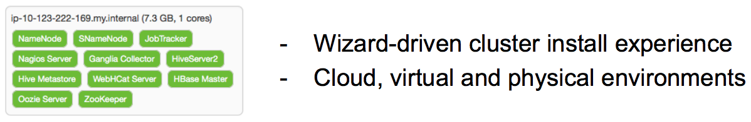
Hadoop Operations With Ambari
Apache Ambari is a 100% open source framework for provisioning, managing and monitoring Hadoop clusters.
Provision: Simplified deployment across platforms
Manage: Consistent controls across the stack
Monitor: Visibility into key cluster metrics

Slide 58
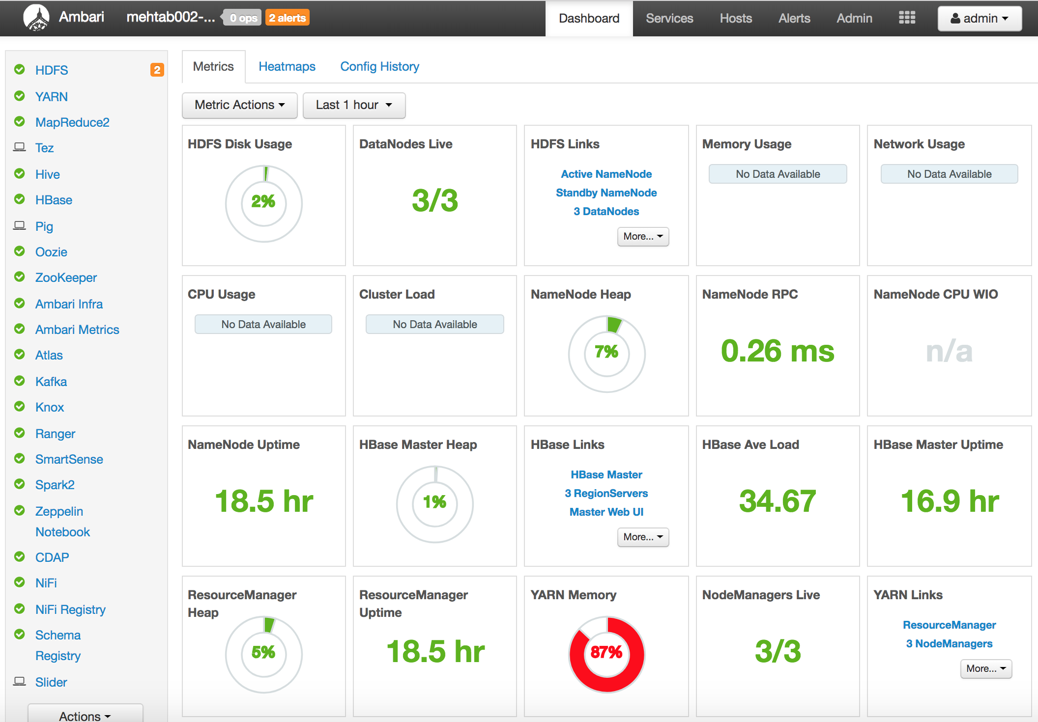
Ambari Web

Slide 59
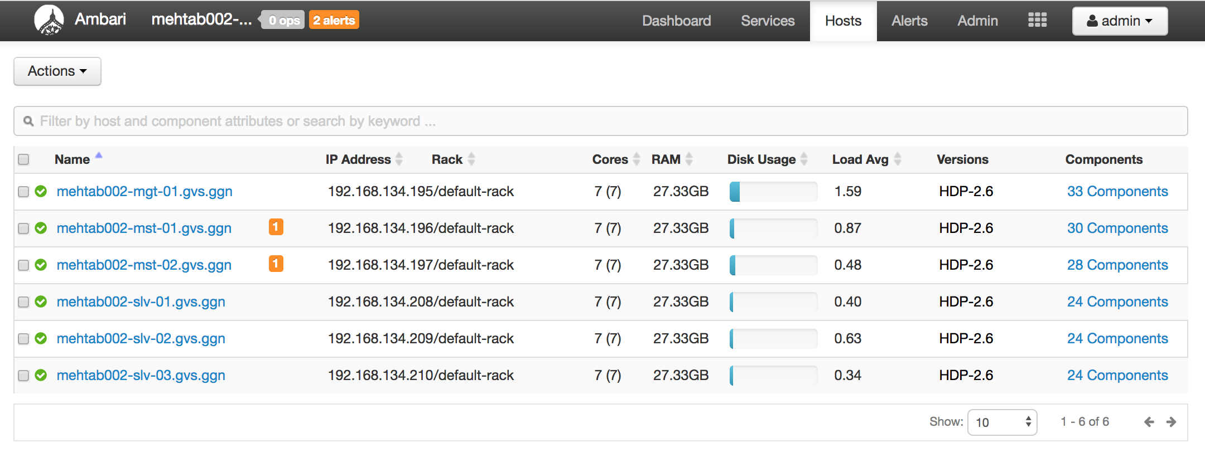
Ambari Web: Host view

Slide 60
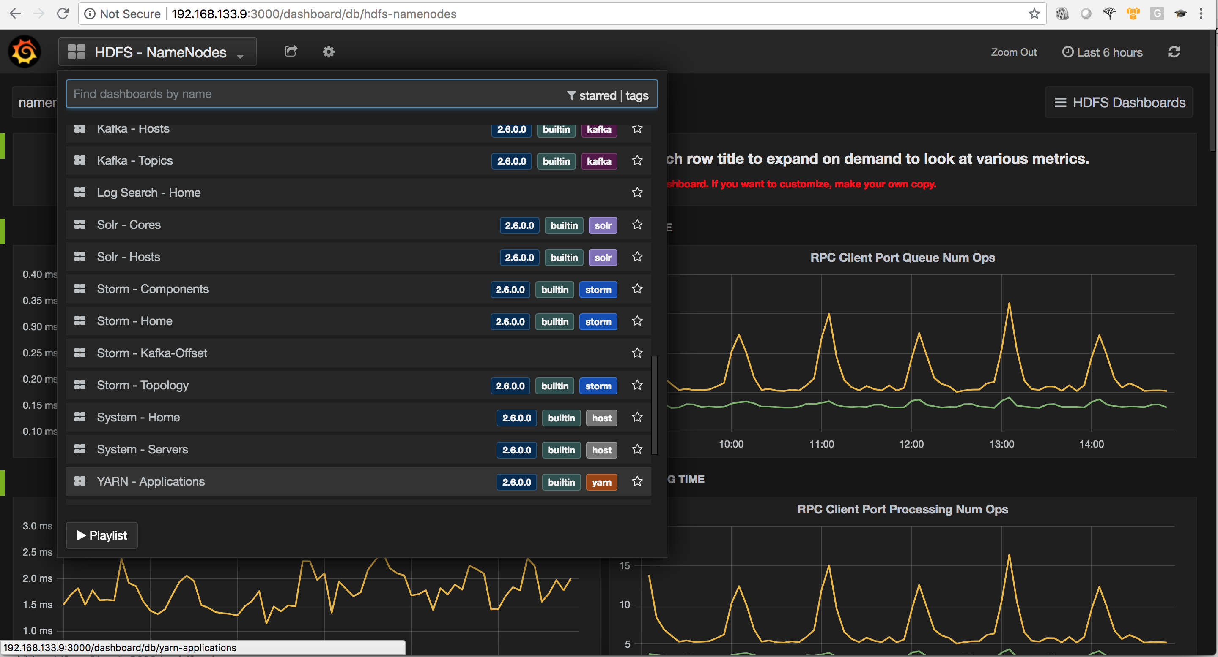
Grafana

Slide 61
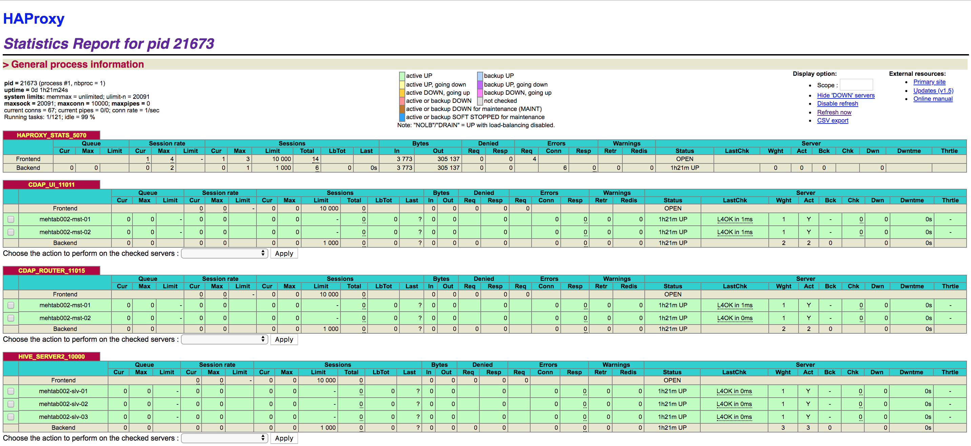
LoadBalancer

Slide 62
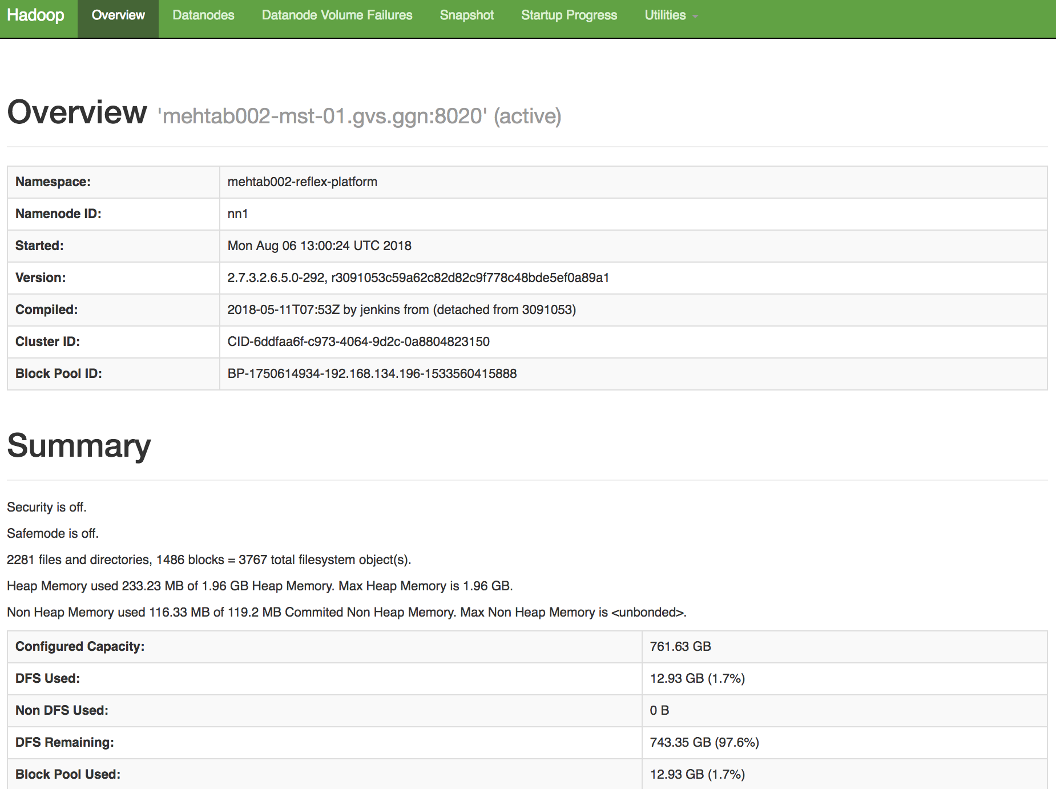
HDFS Web UI

Slide 63
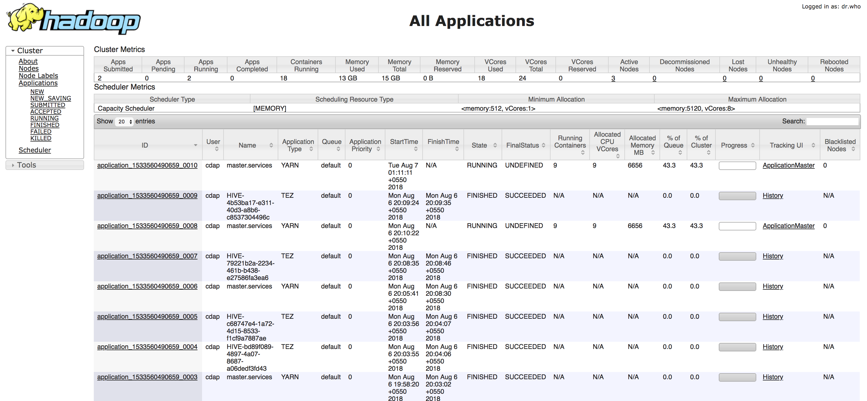
YARN RM UI

Slide 64
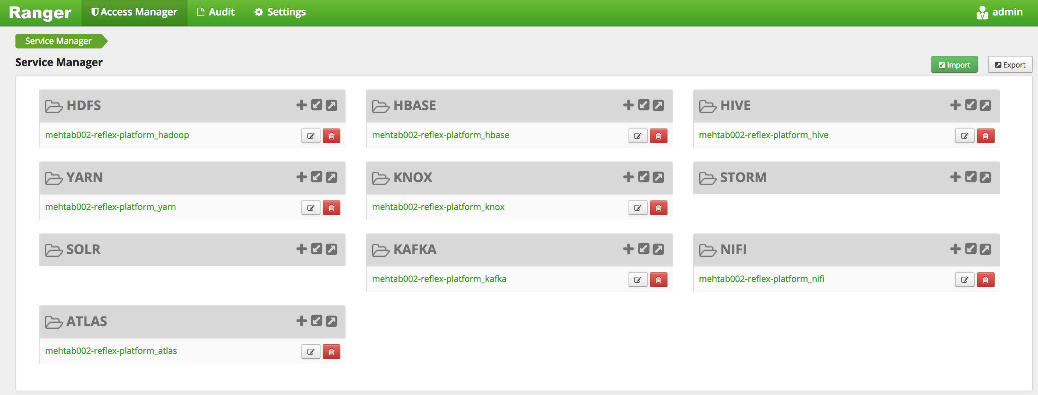
Ranger UI
Note: More in the Security Module

Slide 65
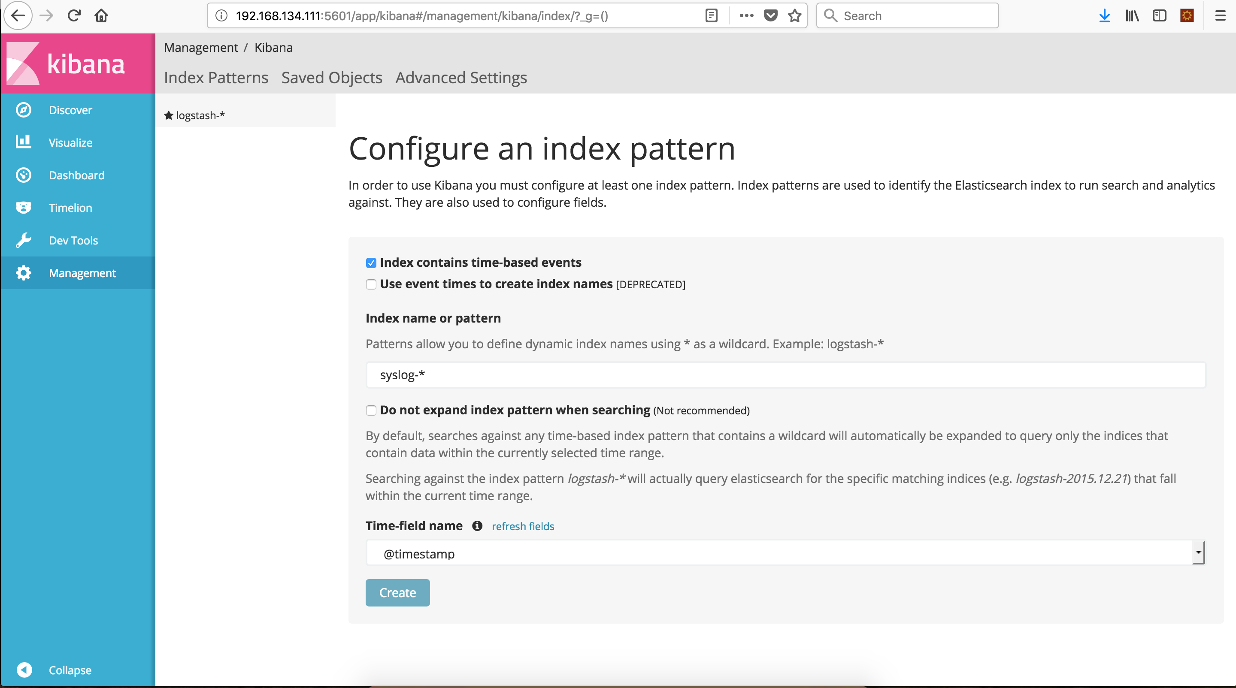
Kibana Log UI(1)

Slide 66
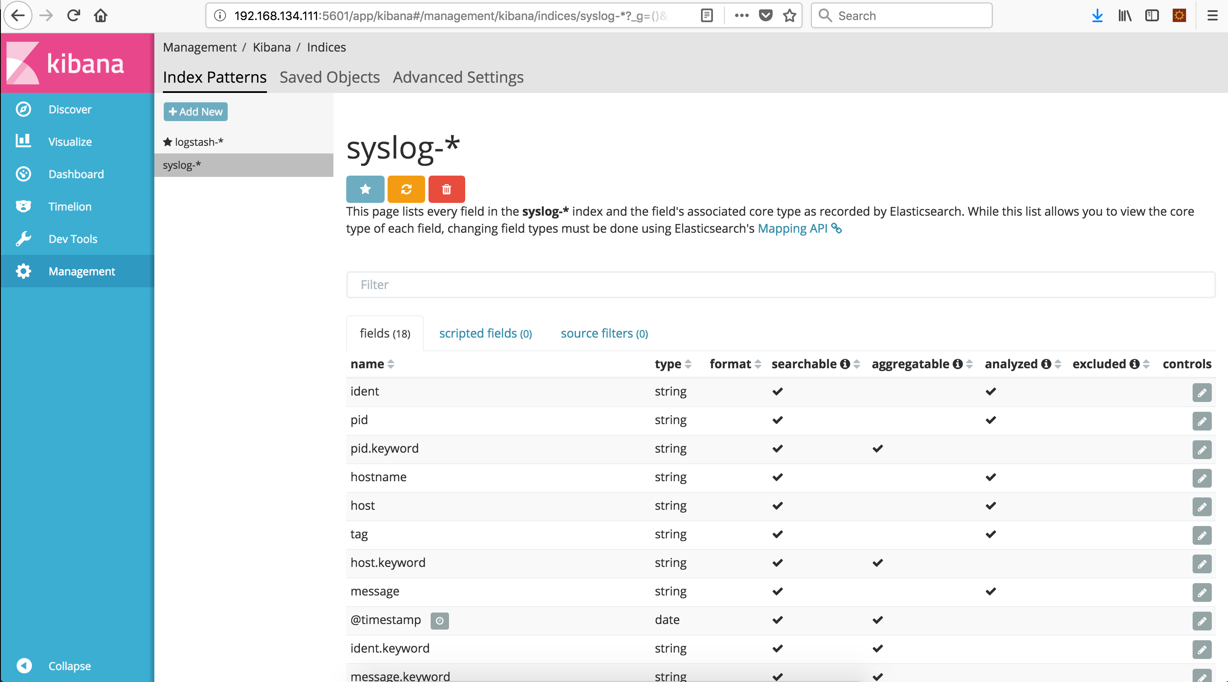
Kibana Log UI (2)

Slide 67
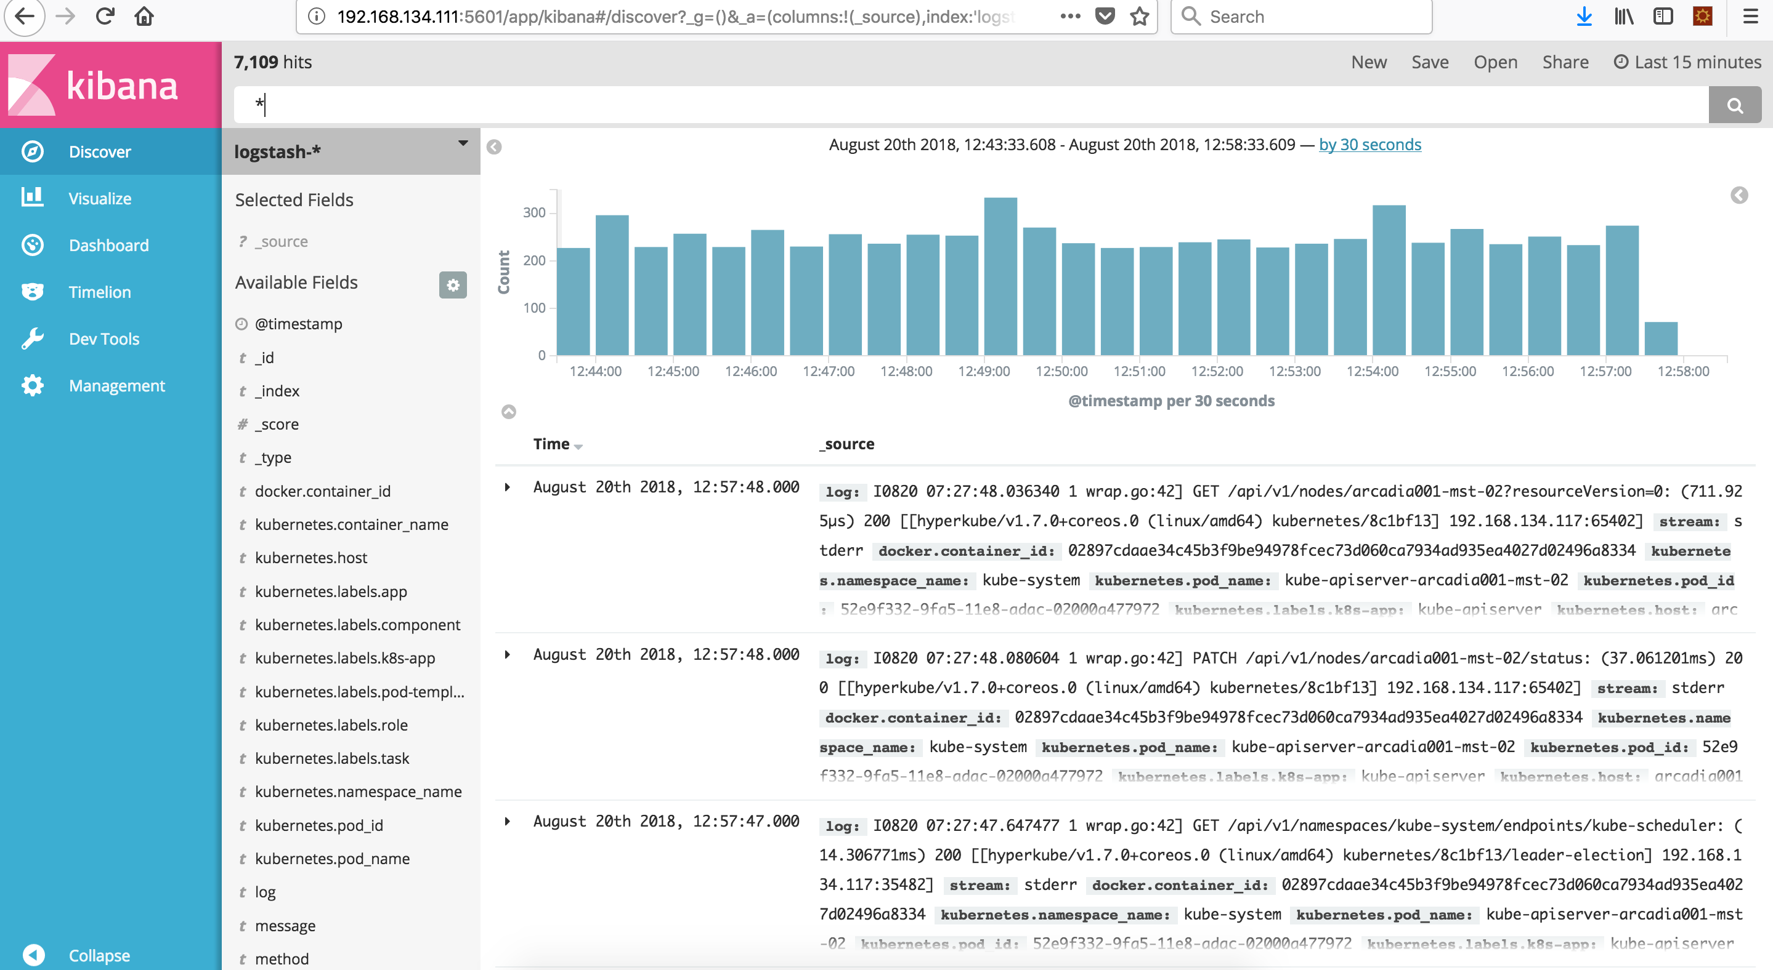
Kibana Log UI (3)

Slide 68
Reflex Internal Logging Framework

Slide 69
Reflex Internal logging framework
Log sources:
Container logs
System logs
Log collection can be expanded by using grok patterns
Fluentd is a good choice for transport as it meets most of these needs – reliability by buffering and failover methods, standardized JSON format, and is very pluggable – meaning developers can add easily.
We use a combination of Fluentd, Elasticsearch and Kibana to collect, store and view logs from the Containers space.

Slide 70
Fluentd – The unsung hero collecting everyone’s logs.
Fluentd is a open source data collector service.
Very optimized, uses very low memory footprint (only 40MB)
Reliable & Scalable
Docker Logging Driver directly listens to the container.
Tagging based syntax allows for future complex scenarios if needed.
Simple flow -
Listen to standard output from all containers.
Match everything and send to Elasticsearch.
View in Kibana
Where do I find this?
roles/kubernetes-apps/fluentd
Runs under kube-system namespace.
Runs as a service in the K8s space, listening on fluentd_in_port
Hostfluentd listens to container drivers and forwards to ES on each host.

Slide 71
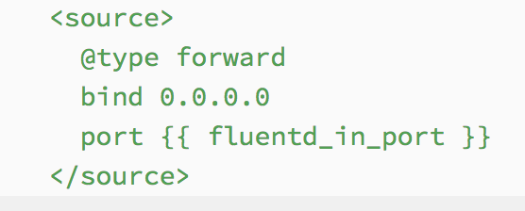
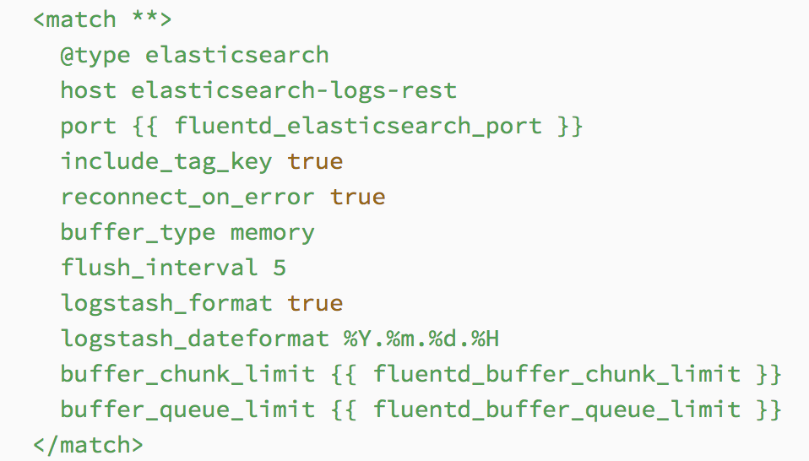
Fluentd – The container that listens to other containers.
Container Apps
App Node
Host Fluend Listener
Container Apps
KIBANA
Operator
Central Fluentd
ES Service - Logging
MGMT node
Developer
App Node
Container Apps
Host Fluend Listener
Container Apps
Notes:
Cleanup every 15 mins, only retains last 5GB of logs across all the indices. Not for individual indices

Slide 72
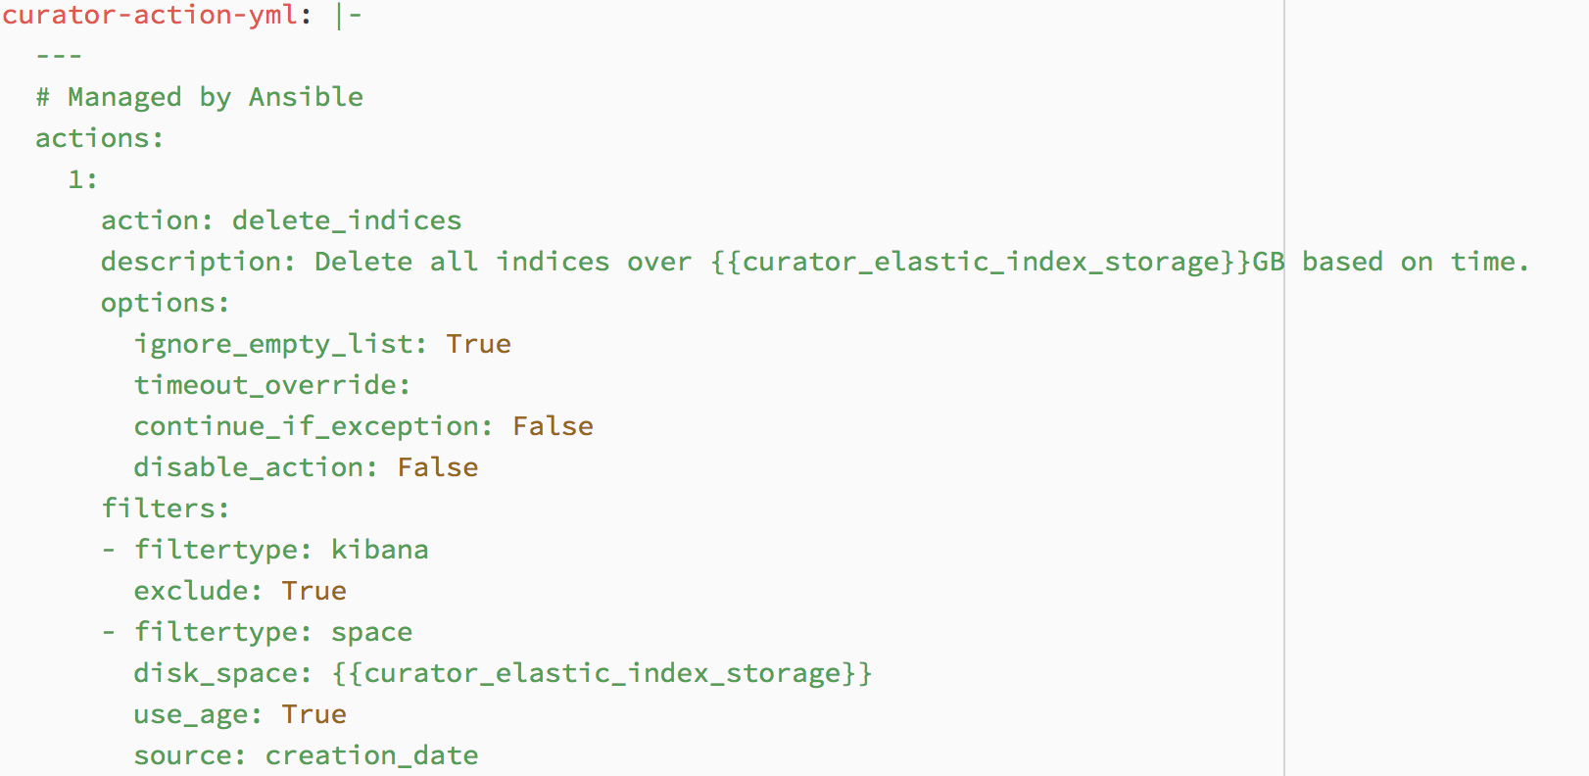
Curator – for log management
We use ES Curator for keeping logs in ES in check.
Template and deployment details are found in roles/kubernetes-apps/curator
Curator runs as system pod under kubernetes-apps
Default value is to clear logs by age over 5GB (configurable)

Slide 73
Elasticsearch and Kibana
We deploy Elasticsearch and Kibana on the management node as containers.
This ES + K pair is separate from the ES-Data pipeline deployment where the latter is for actual data ingestion and parsing and the former is a pure logging service.
ES is deployed as a single instance for logging
Why? The main use case for the local ES log aggregation is for developers to view container logs for development and debugging.
For production, it is recommended to send logs to a central log aggregation cluster which has been sized appropriately.
Instance has been configured as INGEST/MASTER/DATA/HTTPCLIENT roles.
Data directory is - /var/lib/elasticsearch/logs – may be changed if needed.
2G memory allocated to ES-Logs instance.

Slide 74
Summary

